Slide 1




Financial Metrics and Global Stock Market Analysis
Michael S. R. (22229559)
Aqeel R. G. (22229510)
Hizkia G. (22229526)
Group 8

Slide 2
Introduction
This project explores how U.S. economic metrics (such as GDP and CPI) impact the performance of major world stock exchanges. Using Python and the FRED API, we retrieve economic data and compare it with stock price data obtained via the Yahoo Finance API.

Slide 3



RQ1
RQ2
Do stock exchanges in developed countries show a stronger correlation with U.S. GDP than those in developing countries?
How does U.S. GDP influence the performance of U.S. stock exchanges compared to international stock exchanges?
Research Question & Hypotheses
H1
H2
The performance of U.S. stock exchanges is more correlate to the U.S. GDP than international stock exchanges.
Stock exchanges in developed countries show a stronger correlation or are more sensitive to the U.S. GDP compared to those in developing countries

Slide 4
RQ3
RQ4
Do stock exchanges in developed countries show a stronger correlation with U.S. CPI than those in developing countries?
How does U.S. CPI influence the performance of U.S. stock exchanges compared to international stock exchanges?
Research Question & Hypotheses
H3
H4
The performance of U.S. stock exchanges is more correlate to the U.S. CPI than international stock exchanges.
Stock exchanges in developed countries show a stronger correlation with the U.S. CPI metrics compared to those in developing countries

Slide 5
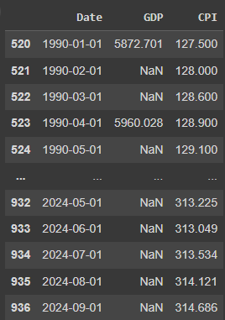
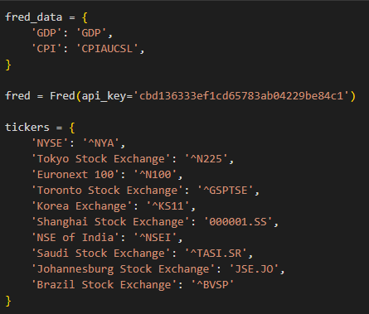
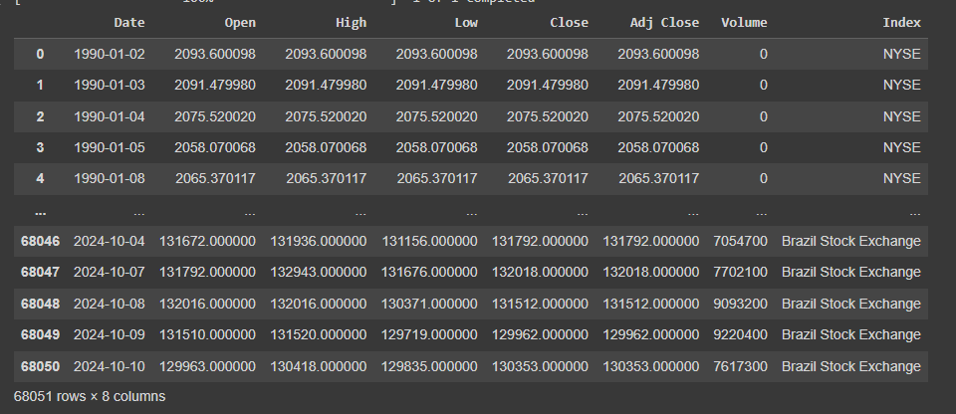
Data Retrieving
Data was retrieved from 2 APIs:
FRED (Federal Reserve Economic Data).
Yahoo Finance/Y-Finance
FRED Data (Monthly, Quarterly for GDP)
Yahoo Finance Price Data (Daily Data)

Slide 6
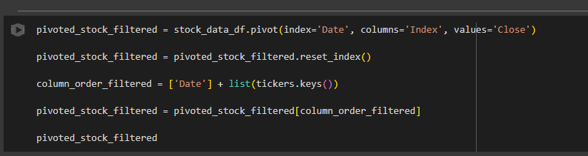
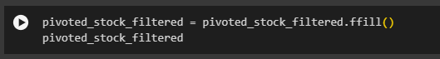
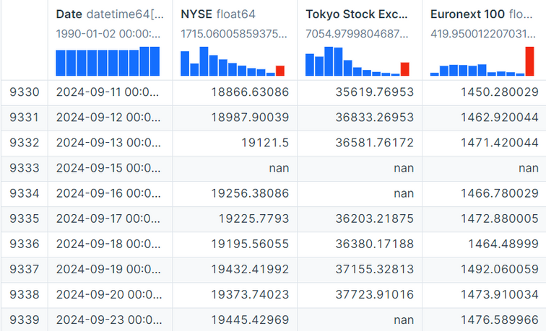

Data Cleaning
For each index, only “Close” prices are extracted.
Set the Name of the Exchange as Column Header.
Filling Missing Values with Forward Fill

Slide 7
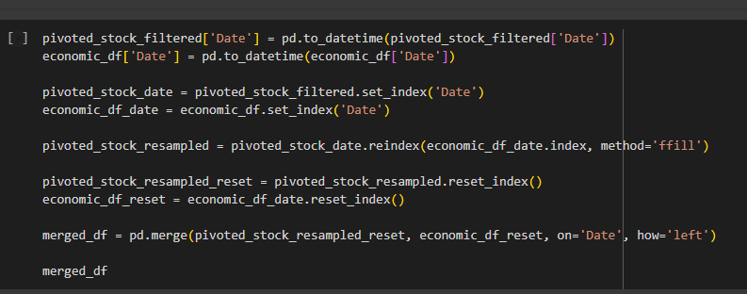
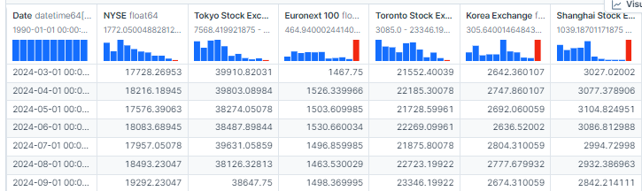
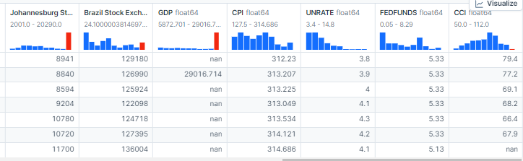
Merge the Data by Date

Slide 8
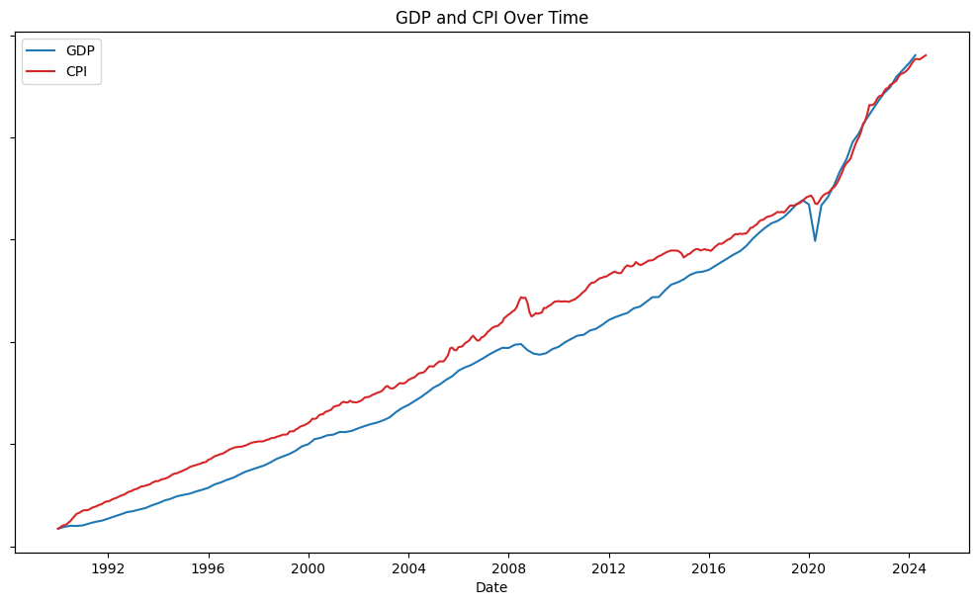
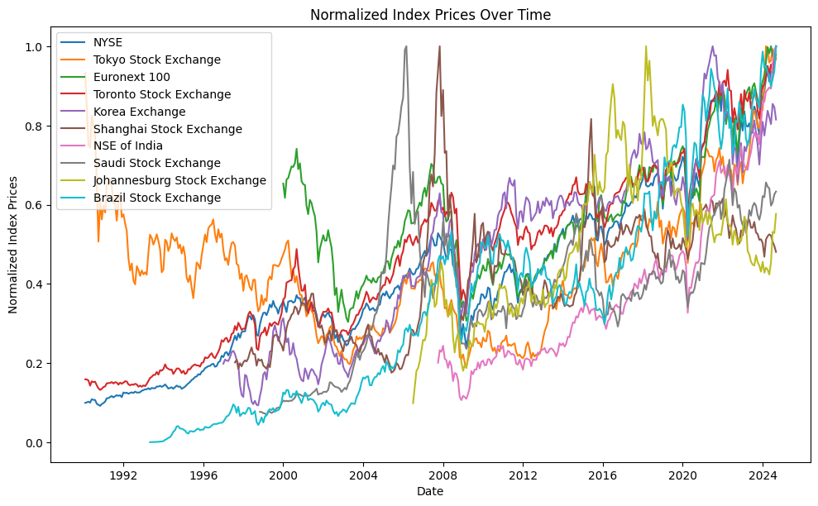
GDP, CPI, UNRATE, FEDFUNDS, and CCI & Stock Index Prices Over Time

Slide 9
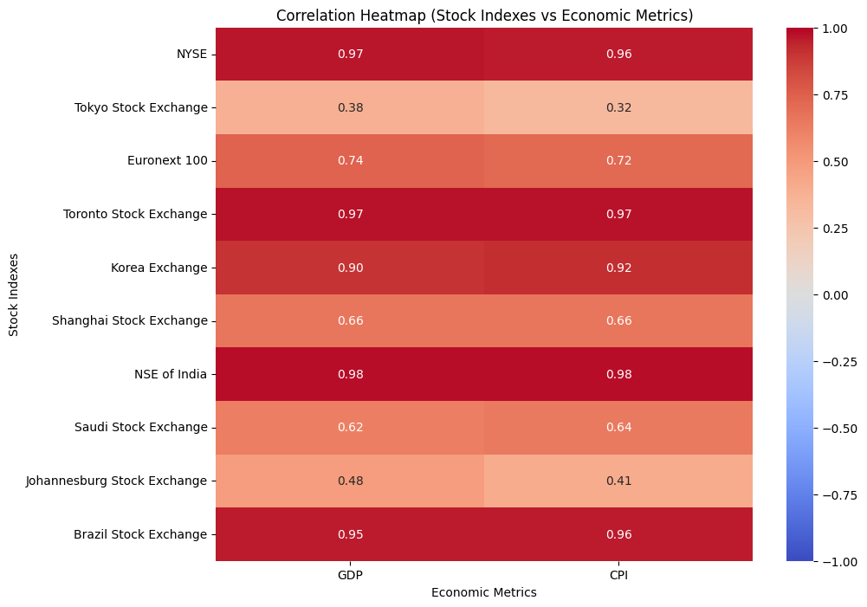
All Time Correlation
NYSE, Toronto Stock Exchange, and NSE of India have strong positive correlations with U.S. economic metrics like GDP and CPI, indicating these exchanges are more influenced by these factors.

Slide 10
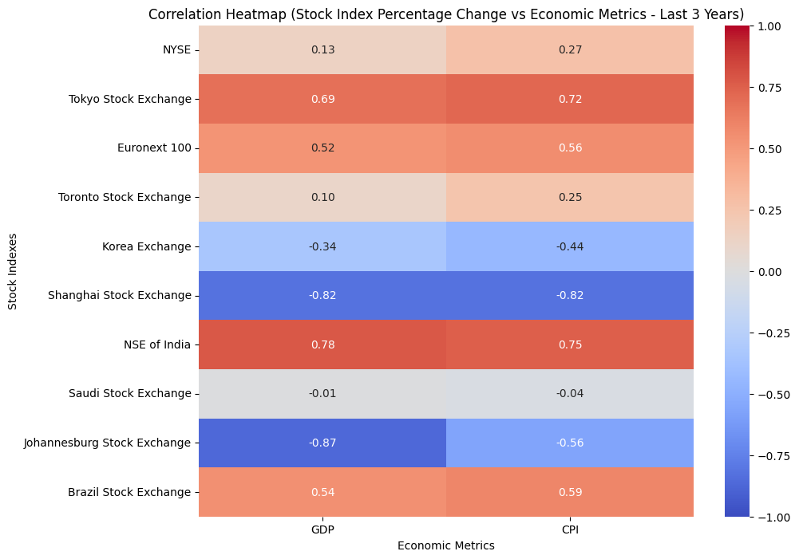
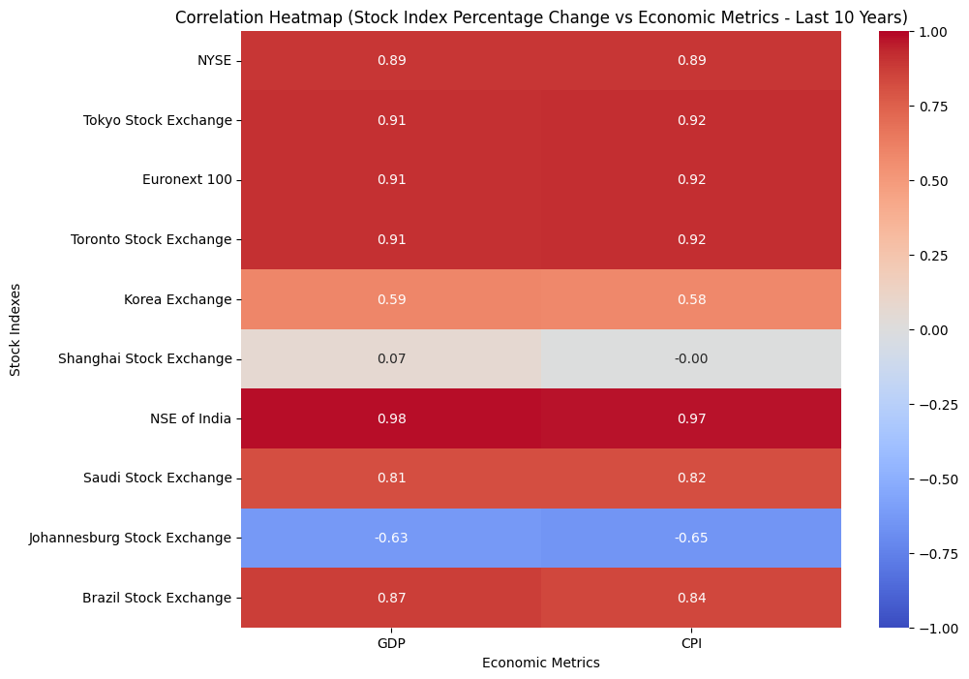
3 years
Period Correlation (3 Years & 10 Years)
01.
10 years

Slide 11
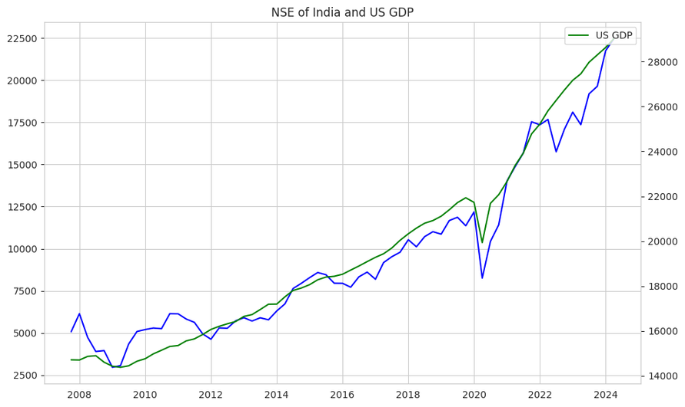
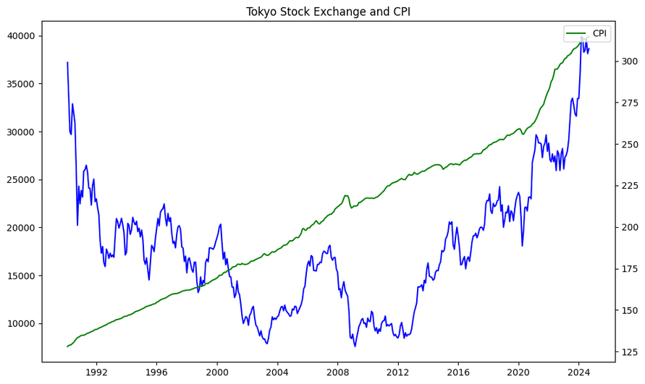
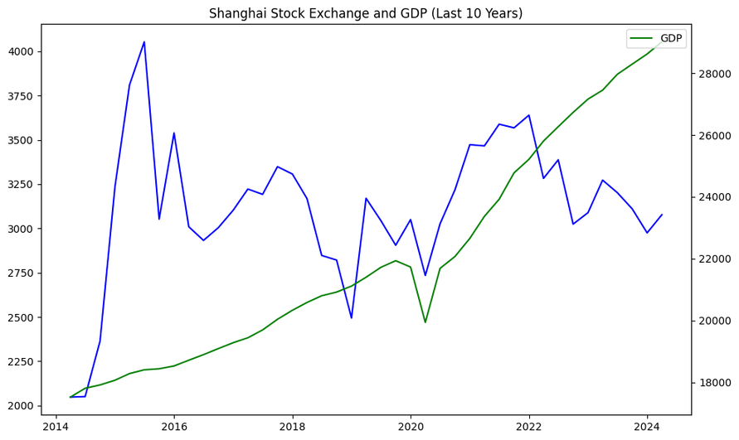
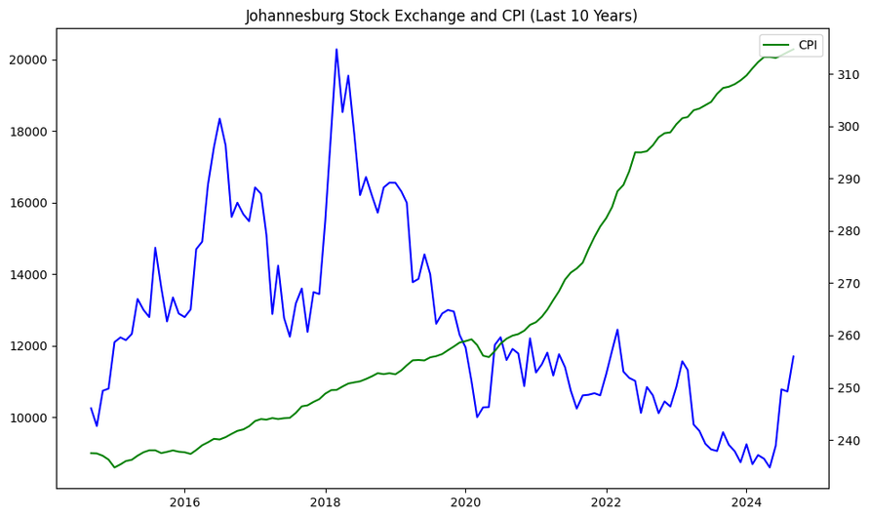
3 years
ρ: 0.98
ρ: 0.32
ρ: 0.07
ρ: -0.65

Slide 12
Hypothesis I
Null Hypothesis (H0): The correlation of NYSE with the GDP is not stronger or the same with the International exchanges with the US GDP.
Alternative Hypothesis (H1): The NYSE have a stronger correlation with the US GDP than the International exchanges with the US GDP
Outcome: From the z-test, the p-value is shown to be 0.0039. This number is below the alpha of 0.05, which means that we reject the null hypothesis and that our hypothesis is true. The U.S Stock Exchange, in this case, the NYSE, is more sensitive to the U.S GDP than other stock exchanges outside of the U.S.

Slide 13
Hypothesis II
Null Hypothesis (H0): Stock exchanges in developed countries have no effect or non-significant correlation with U.S. GDP compared to those in developing countries
Alternative Hypothesis (H1): Stock exchanges in developed countries show a stronger correlation or more sensitive with the U.S. GDP compared to those in developing countries
Outcome: From the z-test, we conclude that our hypothesis is false because the p-value of 0.45. This means that there is no significant difference between the sensitivity of the exchange performance in developed countries and developing countries when correlated to the GDP of the U.S.

Slide 14
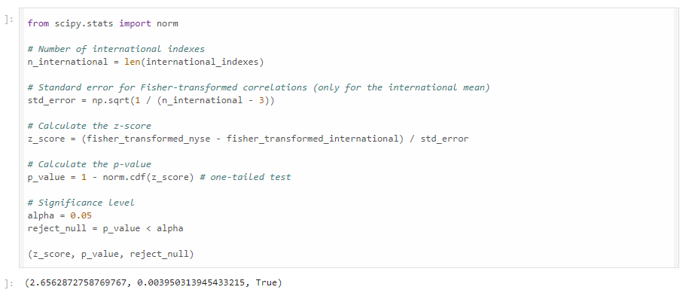
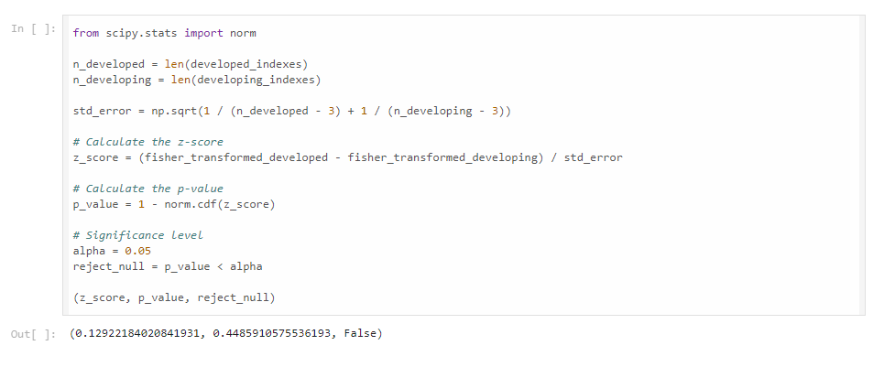
Hypothesis I
Hypothesis II

Slide 15
Hypothesis III
Null Hypothesis (H0): The correlation of NYSE with the CPI is not stronger or the same with the International exchanges with the US GDP.
Alternative Hypothesis (H1): The NYSE have a stronger correlation with the US CPI than the International exchanges with the US CPI.
Outcome: From the z-test, we can conclude that our hypothesis is true because the p-value is below the alpha of 0.05, which is 0.0077. This means the U.S stock exchange is more sensitive to the GDP of the U.S than the international exchanges outside of the U.S.

Slide 16
Hypothesis IV
Null Hypothesis (H0): Stock exchanges in developed countries have no effect or non-significant correlation with U.S. CPI compared to those in developing countries.
Alternative Hypothesis (H1): Stock exchanges in developed countries show a stronger correlation or more sensitive to the U.S. CPI compared to those in developing countries.
Outcome: From the calculated p-value of 0.45 that we got, we failed to reject the null hypothesis because its value is above the alpha of 0.05. This means that there is no statistically significant difference between the sensitivity of the exchange performance in developed countries and developing countries to the CPI of the U.S.

Slide 17
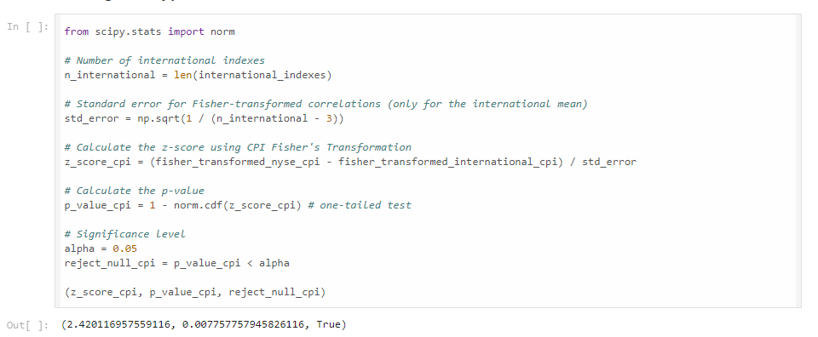
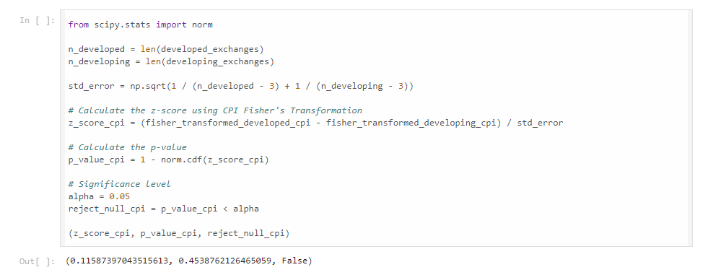
Hypothesis III
Hypothesis IV

Slide 18
CONCLUSION
1. The U.S Stock Exchange is more sensitive to the GDP and CPI of the U.S than the international exchanges outside of the U.S.
2. There are no stastitically significant differences between the sensitivity of the exchange performance in developed countries and developing countries to the GDP and CPI of the U.S.

Slide 19
REFERENCES
Yahoo Finance. (n.d.). *Yahoo Finance*. Retrieved October 13, 2024, from https://finance.yahoo.com/
Federal Reserve Economic Data (FRED). (n.d.). *FRED API documentation*. Federal Reserve Bank of St. Louis. Retrieved October 13, 2024, from https://fred.stlouisfed.org/docs/api/fred/
Deepnote. (n.d.). *Deepnote*. Retrieved October 13, 2024, from https://deepnote.com/
OpenAI. (n.d.). *ChatGPT*. Retrieved October 13, 2024, from https://chatgpt.com/

Slide 20
Thank you very much!

